Slide 1
A case study from Indian e-commerce customers
E-retail factors for customer activation and retention:

Slide 2
Introduction
Customer satisfaction has emerged as one of the most important factors that guarantee the success of online stores; it has been posited as a key stimulant of purchase, repurchase intentions and customer loyalty. A comprehensive review of the literature, theories and models have been carried out to propose the models for customer activation and customer retention. Five major factors that contributed to the success of an e-commerce store have been identified as: service quality, system quality, information quality, trust and net benefit. The research furthermore investigated the factors that influence the online customers repeat purchase intention. The combination of both utilitarian value and hedonistic values are needed to affect the repeat purchase intention (loyalty) positively. The data is collected from the Indian online shoppers. Results indicate the e-retail success factors, which are very much critical for customer satisfaction.

Slide 3
Analysis:-
In this project, The given dataset consists of 71 columns and 269 rows.
The Dataset was first checked for null values, and then the various feature columns were analyzed.
By using various visualization techniques, EDA has been done for the analysis of all the columns in detail, for proper inspection of data, with the help of seaborn visualization technique.

Slide 4
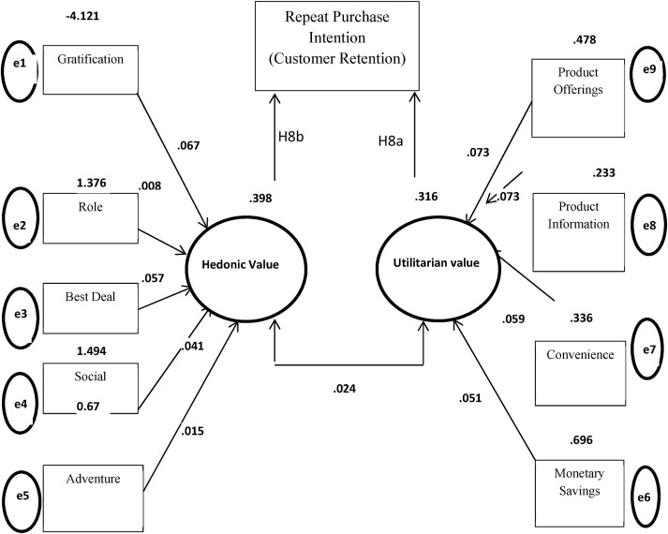
Exploratory Data analysis

Slide 5
DETAILING:-
According to studies it is observed that repeat customer purchase resulting from a long standing loyalty positively affects an e-retailer growth and profitability.
Hedonistic values represent the excitement, and pleasurable experiences derived from shopping online.
Utilitarian shopping values are those related to the level of fulfillment as a result of being able to achieve the shopping goals.
Aside from Hedonic and Utilitarian values, certain perceived risks also influence the purchase decision of an online customer and therefore, these risks are also a crucial factor in determining the loyalty of a customer to an e-commerce brand.

Slide 6
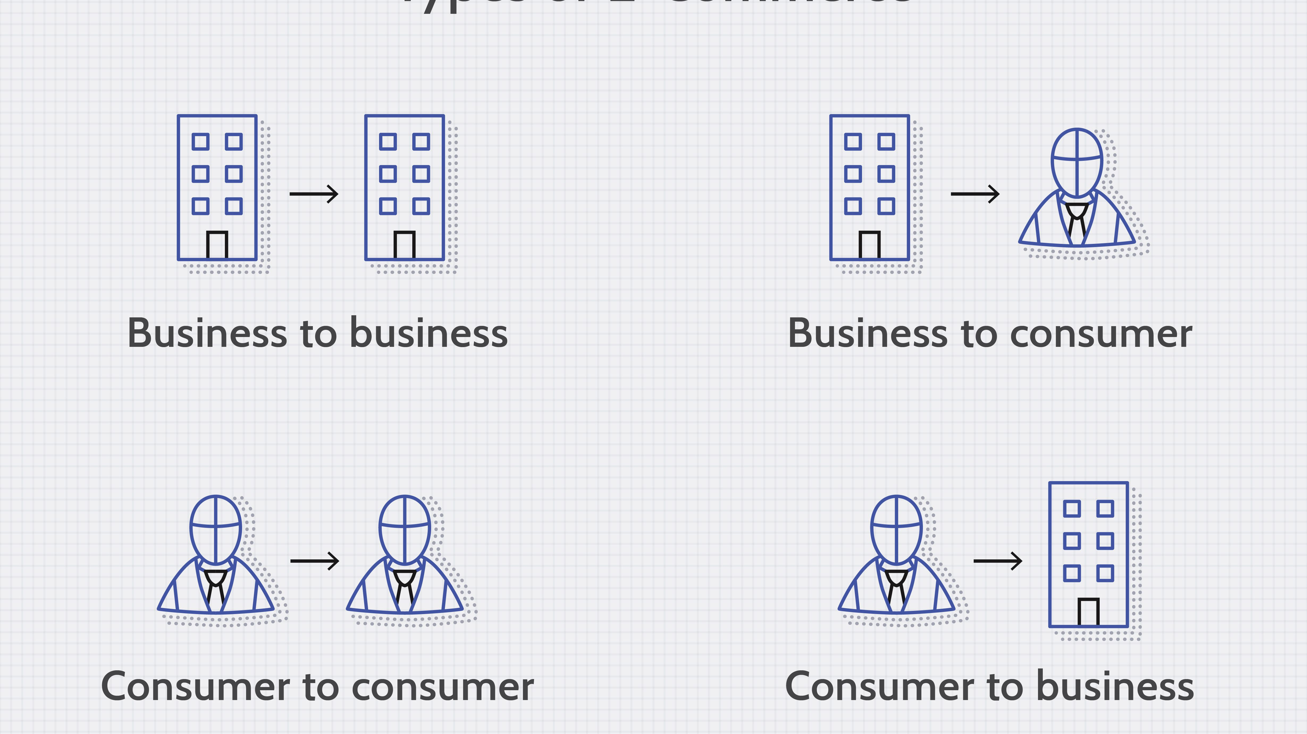
Consumer online shopping activities

Slide 7
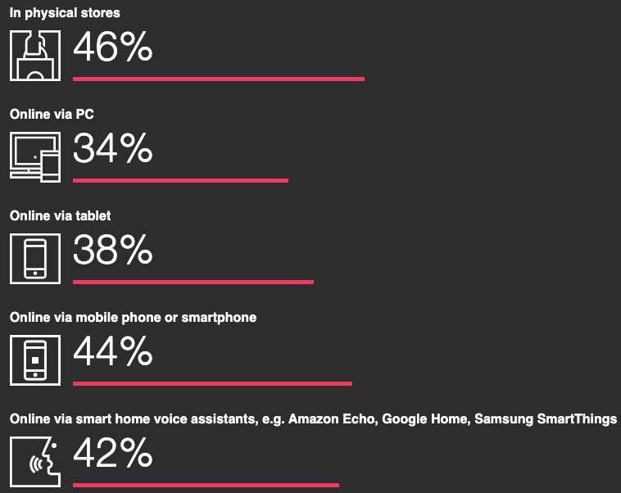
Consumer online shopping preferences:-
Survey says 49% of Indian consumer prefers e-commerce shopping.

Slide 8
consumer opinions on Website Features
Analyzing the opinions of the participants on the various features of the e-commerce websites reveals that Majority of the consumers strongly agree that:
The content on the website must be easy to read and understand
Information on similar product to the one highlighted is important for product comparison
Complete information on listed seller and product being offered is important for purchase decision
All relevant information on listed products must be stated clearly
Navigation in website should be easy
Loading and processing should be quick
Interface of the website must be user friendly

Slide 9

Consumer Ecommerce Website preferences and opinions
Amazon.in, Flipkart.com take the longest time displaying graphics and photos during promotion, sales period.
Most people face Late declaration of price on Myntra and Paytm during promotion, sales period.
Myntra and Paytm take the longest page loading time during promotion, sales period.
Snapdeal.com and Amazon.in have the most limited modes of payment on most products during promotion, sales period.

Slide 10
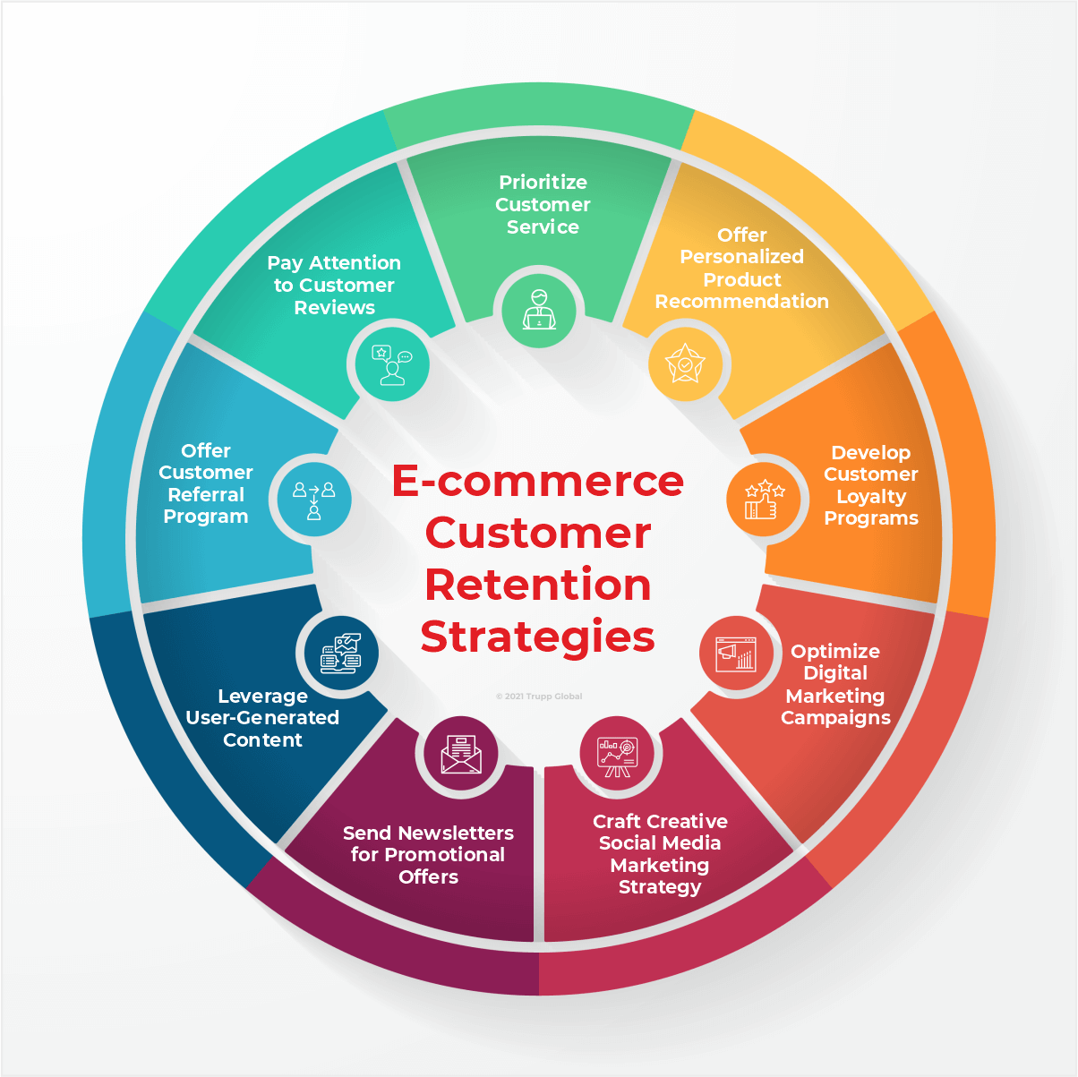
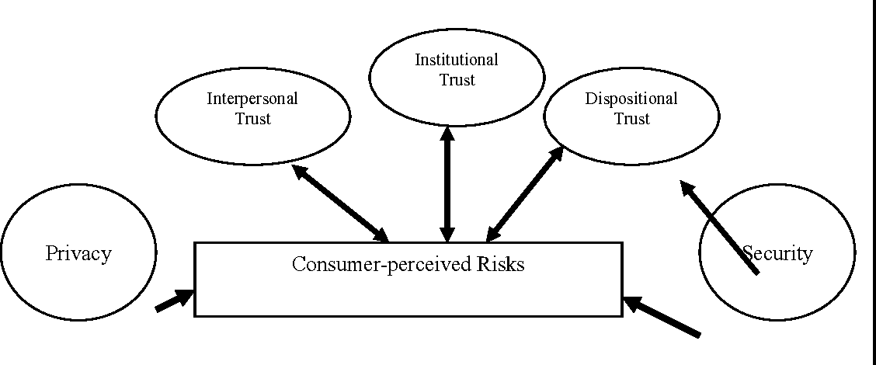
Analyzing Relationship between Customer retention and Perceived Risks
CUSTOMER RETENSION
PERCEIVED RISK

Slide 11
Analyzing Relationship between Customer retention and Perceived Risks
Columns that represent abandoning shopping carts on e commerce websites, reasons behind abandoning shopping carts,Longer delivery period,Website disruption,Customer Data security,Trustworthiness etc. represent perceived risks
While the Column representing the recommended e commerce brands represents customer loyalty / retention.
The relationships between the columns representing the perceived risks and the column representing Customer retention were visualized and observations were made.

Slide 12
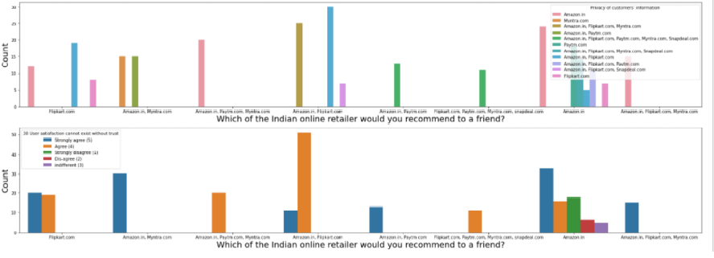
Analysing Relationship between Customer retention and Perceived Risks

Slide 13
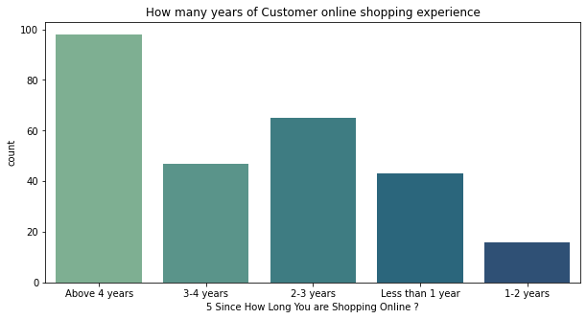
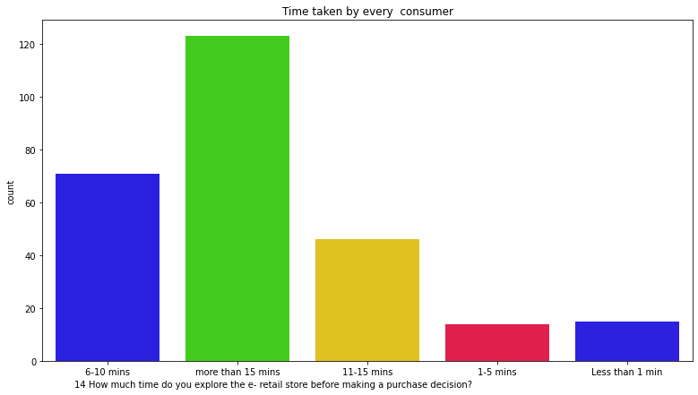
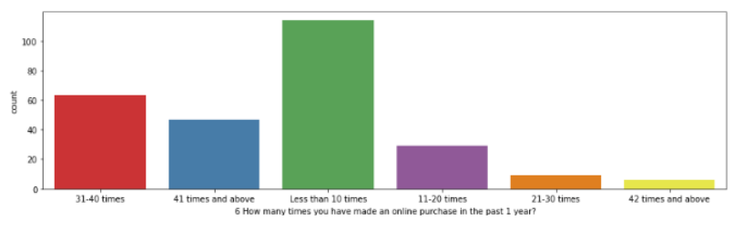
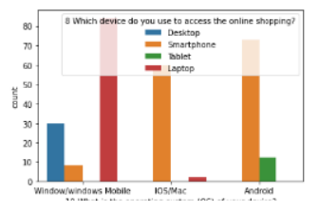
Online shopping Timeline

Slide 14
Analyzing Relationship between Customer retention and Utilitarian Value
CUSTOMER RETENTION
UTILITARIAN VALUE
CUSTOMER RETENSION refers to the number of customers a business can retain over time.
customer retension is directly proportional to number of customers.
Utilitarian values are based on rational decisions,are goal related and give importance to functional values of products / transactions on websites that are aimed at enhancing customer satisfaction through meaningful online transactions

Slide 15
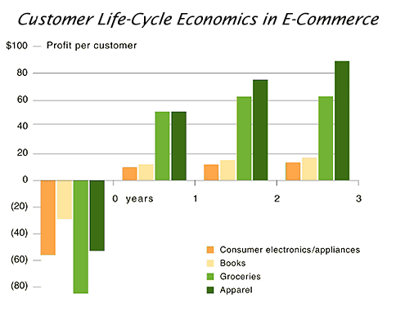

Analyzing Relationship between Customer retention and Utilitarian Value
CUSTOMER RETENSION
UTILITARIAN VALUE

Slide 16
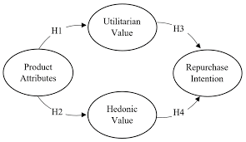
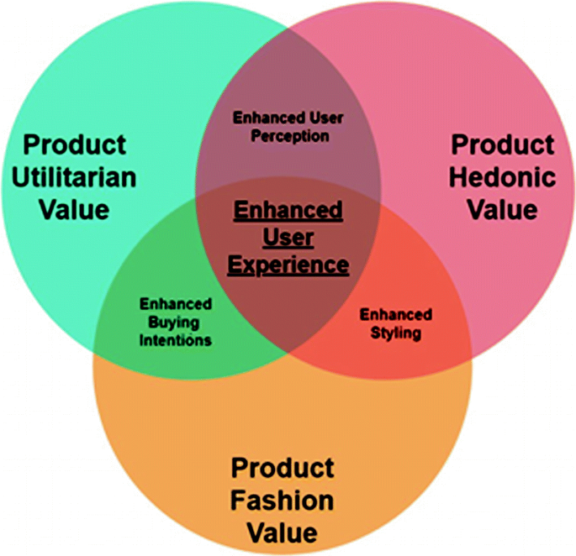
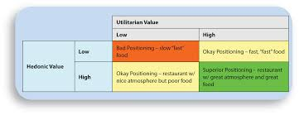
Analyzing Relationship between Hedonic value and Utilitarian Value

Slide 17
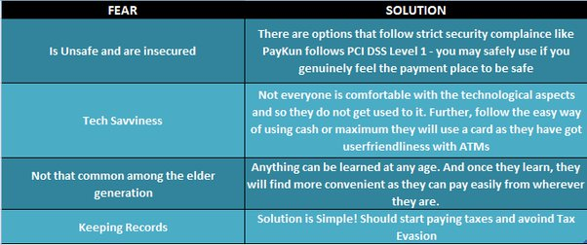
Consumer Hesitation

Slide 18
conclusion
From the above Exploratory Data Analysis, it is determined that for any website to retain customers,for the growth of its customer-base and to build and maintain a successful business, it is important that the E-tailers focus on enhancing customer experience in shopping on their websites, while ensuring that all of their particular hedonic and utilitarian needs are satisfied, while taking steps to minimise the perceived risks. Offering a huge variety of products, impeccable website design, user friendly interface, a huge variety of safe and convenient payment options, offering strong data security and privacy, helpful, empathetic support staff and impeccable customer service, optimised website processes that universally load in optimal time on all types of platforms and systems, faster delivery etc are vital to ensure customer loyalty to the brand of the e-tailer Experienced customers, give great importance to their experiences of previous purchases, which in turn speeds up the process of attaining their shopping goals.

Slide 19
conclusion
From the above Exploratory Data Analysis, it is determined that for any website to retain customers,for the growth of its customer-base and to build and maintain a successful business, it is important that the E-tailers focus on enhancing customer experience in shopping on their websites, while ensuring that all of their particular hedonic and utilitarian needs are satisfied, while taking steps to minimise the perceived risks. Offering a huge variety of products, impeccable website design, user friendly interface, a huge variety of safe and convenient payment options, offering strong data security and privacy, helpful, empathetic support staff and impeccable customer service, optimised website processes that universally load in optimal time on all types of platforms and systems, faster delivery etc are vital to ensure customer loyalty to the brand of the e-tailer Experienced customers, give great importance to their experiences of previous purchases, which in turn speeds up the process of attaining their shopping goals.

